Slide 1
The Effect of Online Reviews on Movie Box Office Sales: An Integration of Aspect-Based Sentiment Analysis and Economic Modeling
Group - 10
Nafiz Siddiqui Adnan [20301016] ST: Md Mustakin Alam RA: Md Sabbir Hossain

Slide 2
Using movie industry as a case study owing to the availability of its sales data
Introduction
Electronic Word-of-Mouth (eWOM):
Numerical Rating
Text of the Review
Integration of ABSA and Economic Modeling to explore the various features that influence box office revenues

Slide 3
Relevant Literature
Impact of eWOM on Sales
The impact of eWOM on sales has substantially increased due to the proliferation of eWOM on social media.
eWOM has been shown to significantly affect sales for products such as books, movies, and mobile apps.
Sentiment Analysis and Aspect-Based Sentiment Analysis
Sentiment analysis is a subfield of NLP that extracts emotions related to raw texts.
Sentiment scores obtained from movie reviews improve the accuracy of box-office performance predictions.
ABSA method to break down text into aspects and allocate a sentiment level.

Slide 4
Sources
IMDb
Box Office Mojo
Data & Variables
Variables
Theater
Week
Review
Rating
Genre

Slide 5
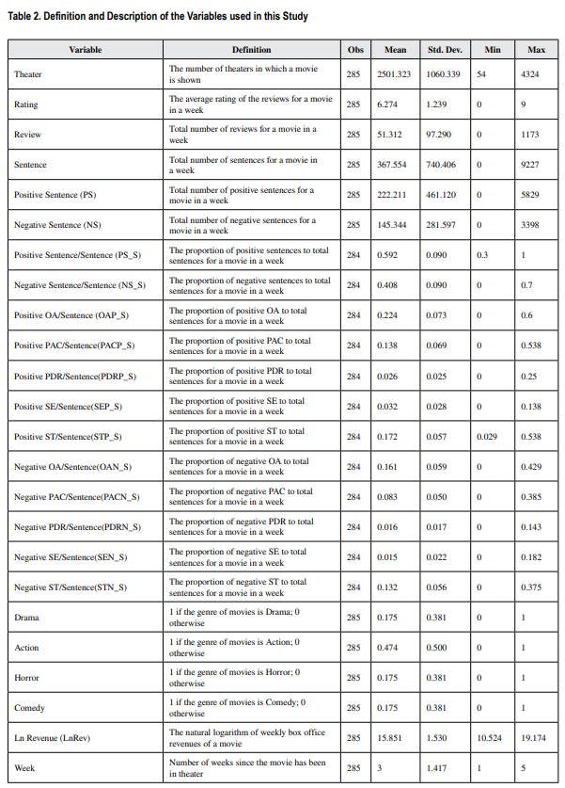
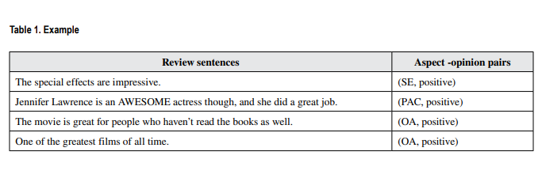
Example of Preprocessing Module
“The special effects are impressive. Jennifer Lawrence is an AWESOME actress though, and she did a great job. The movie is great for people who haven’t read the books as well. One of the greatest films of all time”

Slide 6

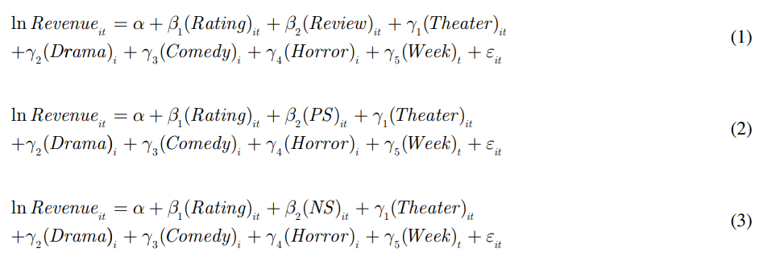
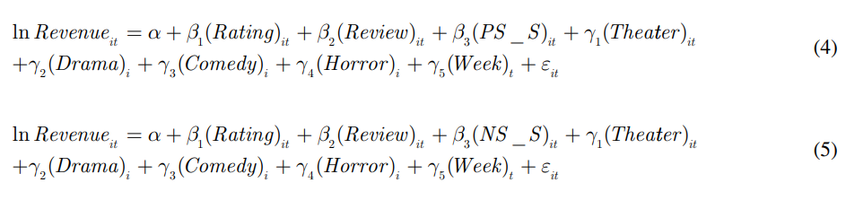
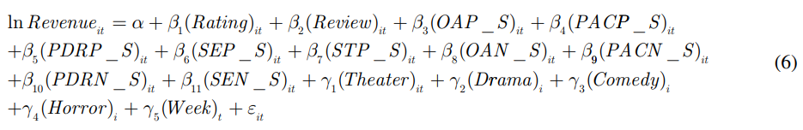
Empirical Model :
Baseline Models :
Methodology
Extended Models :

Slide 7
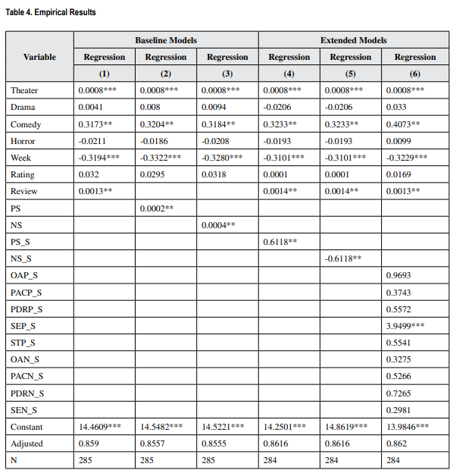
Results & Implication
Result
both positive and negative reviews increase movie revenues
Managerial Implication
Film Companies should:
sprinkle movie trailer through major social media platform
invite opinion leaders and reviewers to promote their movies and generate social media exposure

Slide 8
Conclusion & Limitations
Data consists of movies released in the USA only. So, results may vary for other regions.
The impact of negative reviews may not hold true if the ticket price is too expensive.
THANK YOU

